Slide 1
WEB AUTHORING: DW, PHP, MYSQL
SESSION 03 – TABLES AND STYLE TAGS

Slide 2
OBJECTIVES
Introduction to table
Draw table in HTML
Table rows, table columns, table heading
Table span
Styles: font, format

Slide 3
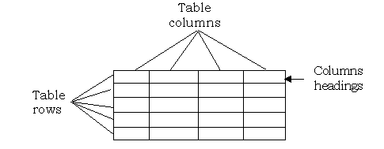
Introduction to table

Slide 4
HTML tables
Tables are defined with the <table> tag.
A table is divided into rows (with the <tr> tag)
Each row is divided into data cells (with the <td> tag).
td stands for "table data" and holds the content of a data cell.
A <td> tag can contain text, links, images, lists, forms, other tables, etc.

Slide 5
Table example
<table border="1"> <tr> <td>row 1, cell 1</td> <td>row 1, cell 2</td> </tr> <tr> <td>row 2, cell 1</td> <td>row 2, cell 2</td> </tr> </table>

Slide 6

Table output

Slide 7

HTML Table Headers
Header information in a table are defined with the <th> tag.
The text in a th element will be bold and centered.
<table border="1"> <tr> <th>Header 1</th> <th>Header 2</th> </tr> <tr> <td>row 1, cell 1</td> <td>row 1, cell 2</td> </tr>
</table>

Slide 8
Elements with table
<table></table>
<tr></tr>
<th></th>
<td></td>
<caption></caption>
Add Cell Space
The CELLSPACING attribute defines the space between cells in pixels. The CELLPADDING attribute defines spaces within the table cell.
<TABLE BORDER = 2 CELLSPACING = 2 CELLPADDING = 6>

Slide 9
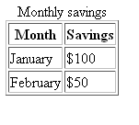
Table with Caption
<table border="1">
<caption>Monthly savings</caption>
<tr>
<th>Month</th>
<th>Savings</th>
</tr>
<tr>
<td>January</td>
<td>$100</td>
</tr>
<tr>
<td>February</td>
<td>$50</td>
</tr>
</table>

Slide 10
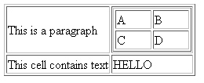
Nested Table
<table border="1">
<tr>
<td><p>This is a paragraph</p></td>
<td>
<table border="1" width=100>
<tr>
<td>A</td>
<td>B</td>
</tr>
<tr>
<td>C</td>
<td>D</td>
</tr>
</table>
</td>
</tr>
<tr>
<td>This cell contains text</td>
<td>HELLO</td>
</tr>
</table>

Slide 11
Formatting Data in the Cell
Align = left
Align = center
Align = right
Align = justify
Valign = top
Valign = middle
Valign = bottom
Valign = baseline
<TD ALIGN = right VALIGN = bottom>Data Cell 1</TD>

Slide 12
Merging Cells
The COLSPAN and ROWSPAN attributes are used to create cells that span more than one column or row
COLSPAN="C": specifies how many columns “C” of the table a data cell will span. COLSPAN="1" is the default.
ROWSPAN="R": specifies how many rows “R” of the table a data cell will span. ROWSPAN="1" is the default.

Slide 13
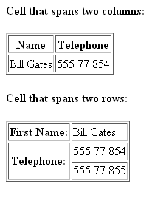
Span example
<table border="1"><tr>
<th>Name</th>
<th colspan="2">Telephone</th>
</tr><tr> <td>Bill Gates</td>
<td>555 77 854</td>
</tr></table>
<table border="1">
<tr> <th>First Name:</th>
<td>Bill Gates</td>
</tr><tr>
<th rowspan="2">Telephone:</th>
<td>555 77 854</td>
</tr><tr>
<td>555 77 855</td>
</tr></table>

Slide 14
Style tags
<FONT>text</FONT>: changes the face (type), size, and/or color of ordinary text.
A <FONT> tag may contain within it any or all of the 3 parameters used to transform text:
FACE="TYPE": sets or changes the face (type) of font script
SIZE="1"|"2"|"3"|"4"|"5"|"6"|"7": sets the size of the text.
COLOR="COLOR"|"#COLOR CODE": sets the color of the text.

Slide 15
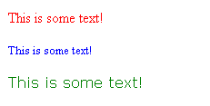
Font sample
<p><font size="3" color="red">This is some text!</font></p>
<p><font size="2" color="blue">This is some text!</font></p>
<p><font face="verdana" color="green">This is some text!</font></p>

Slide 16
Other style tags
<I>text</I>: causes text to be italicized
<EM>text</EM>: emphasizes text by causing it to be italicized (like <I> & </I> above)
<B>text</B>: causes text to be bold
<STRONG>text</STRONG>: strongly emphasizes text by causing it to be bold (like <B> & </B> above)
<U>text</U>: causes text to be underlined
<S>text</S>: causes text to be stricken through with a horizontal line
<BIG>text</BIG>: causes the size of text to be increased by one font size
<SMALL>text</SMALL>: causes the size of text to be decreased by one font size

Slide 17
Marquee
<MARQUEE>text</MARQUEE>: creates an area in which moving text will advance across all or a portion of a page
A <MARQUEE> tag may contain within it other parameters as part of the command:
DIRECTION="LEFT"|"RIGHT": indicates the direction marquee text will move.
BGCOLOR="COLOR"|"#COLOR CODE": colors the background of a marquee.
BEHAVIOR="SCROLL"|"SLIDE"|"ALTERNATE": specifies how marquee text will behave as it moves horizontally on a browser screen

Slide 18
Summary
This session, we learnt:
<TABLE>row(s) of data cells</TABLE>: creates a table with a row or rows of one or more cells, each cell containing data
<TR></TR>: defines each horizontal row of table data cells inside of a table.
<TH>text</TH>: places an optional heading above any column of a table
<TD>text and/or graphic images</TD>: defines each table data cell within a row, into which text and/or graphic images may be placed.
Colspan and Rowspan, allow you to extend columns and rows across multiple other columns and rows
<FONT>text</FONT>: changes the face (type), size, and/or color of ordinary text
<MARQUEE>text</MARQUEE>: creates an area in which moving text will advance across all or a portion of a page, just as it does on some marquee signs.

